Slide 1
Math Placement at Utica College
Superintendents Breakfast
April 19, 2012

Slide 2

Mathematics Association of America (MAA) has provided math placement testing since 1977.
Utica College has used the MapleSoft/MAA online placement test suite since Fall 2007.
MAA placement tests are rigorously validated.

Slide 3
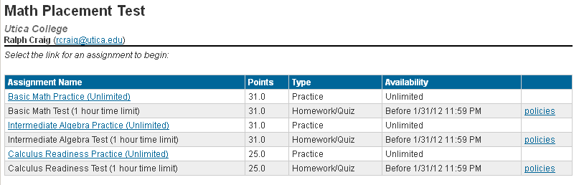
Test consists of three graduated timed sections. One hour for each section.
Satisfactory score (70%) on each section required to take the next.
Each section is paired with a practice session with unlimited time.

Slide 4
Based on test results, students are placed into one of four categories:
Category 1: Student has not achieved a satisfactory score on Basic Math section.
Category 2: Student has passed Basic Math but not Intermediate Algebra.
Category 3: Student has passed Intermediate Algebra but not Calculus Readiness.
Category 4: Student has passed the Calculus Readiness section of the test.

Slide 5
Category 1: Student must register for
  MAT 100 - Basic Math
Category 2: Student may register for
  MAT 104 – Intermediate Algebra
  MAT 107 – Introduction to Math
  MAT 112 – Basic Statistics
Category 3: Student may register for
  MAT 143 – Business Algebra
  MAT 151 – Precalculus
Category 4: Student may register for
  MAT 201 – Calculus I
  Student may not register for MAT 104/151.
  Student is exempt from 3 credits of math core.

Slide 6
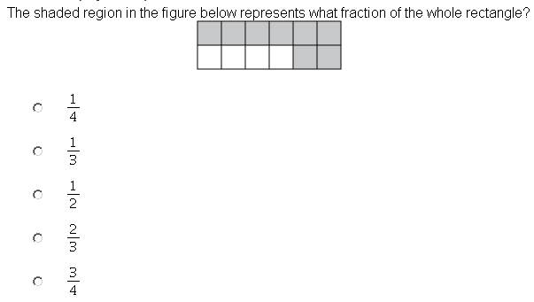
Basic Math Sample Question

Slide 7
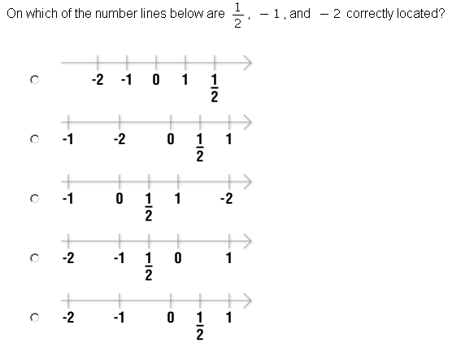
Basic Math Sample Question

Slide 8
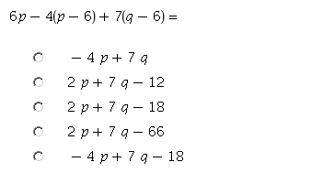
Intermediate Algebra Sample Question

Slide 9
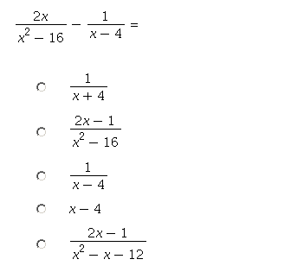
Intermediate Algebra Sample Question

Slide 10
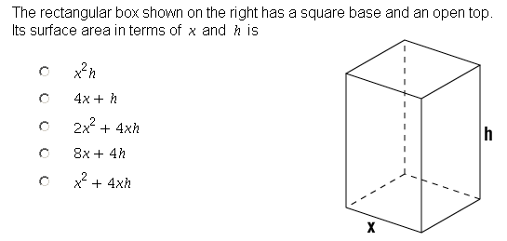
Calculus Readiness Sample Question

Slide 11
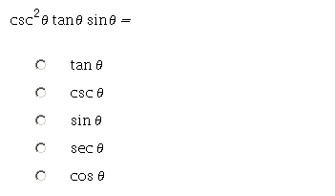
Calculus Readiness Sample Question

Slide 12
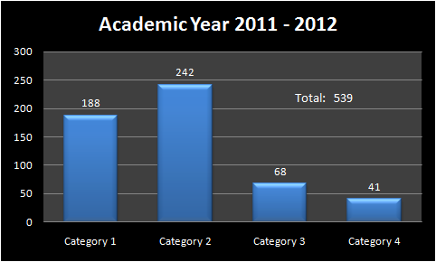
Data only includes students who completed the math placement test for 2011 – 2012.

Slide 13
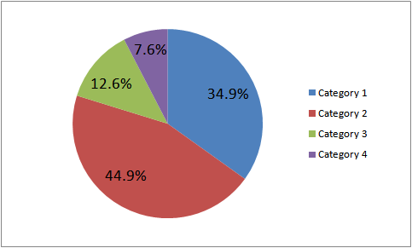
Math Placement Test Results
Academic Year 2011-2012

Slide 14
Math Placement Test is waived if:
  Student transfers college math course equivalent to a UC math course.
  Student transfers with an Associates Degree, is exempt from core educational requirements.
  Student has scored 4 or 5 on the AP Calculus AB or Calculus BC exam.
Some students elect to skip the test and register for MAT 100 – Basic Math.

Slide 15
During academic year 2011 – 2012 the enrollment in MAT 100 was 226 students.
For the same year the number of student placed into MAT 100 was 188 students.
A significant number of students elect to skip the math placement test and register for MAT 100.

